Slide 1
Team Names & IDs
حازم محمد احمد بكر 20221441999
أحمد حسين حسن دويدار 20225926030
مروان حسن إبراهيم احمد20221447788
مروان اشرف محمد عبدالباقي محمد 20221442040
مصطفى صالح مصطفى محمد20221453750

Slide 2
Dataset name , description and dimensions
Chinese Traffic Signs
Dataset link :- https://www.kaggle.com/datasets/dmitryyemelyanov/chinese-traffic-signs/download?datasetVersionNumber=2
description :-
Dataset consists of 5998 traffic sign images of 58 categories. Each image is a zoomed view of single traffic sign. Annotations provide image properties
(file_name, width, height) as well as traffic sign coordinates within image and category (e.g. 5 km/h speed limit)

Slide 3
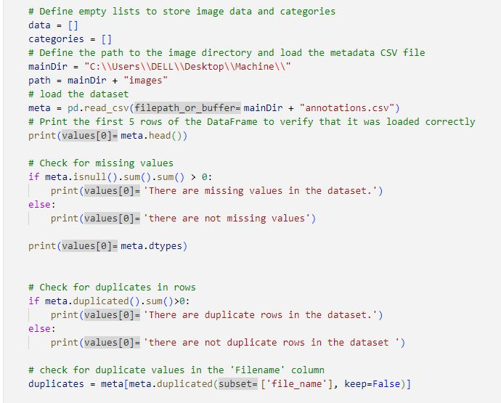
Code of analysis & cleaning :-

Slide 4
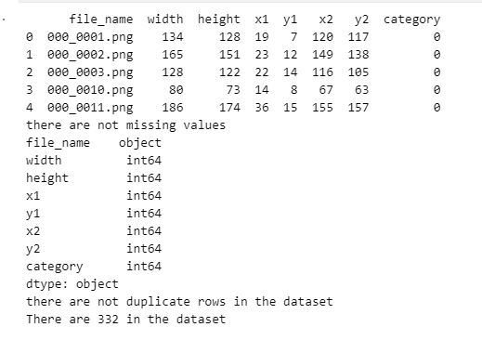
Output :-

Slide 5
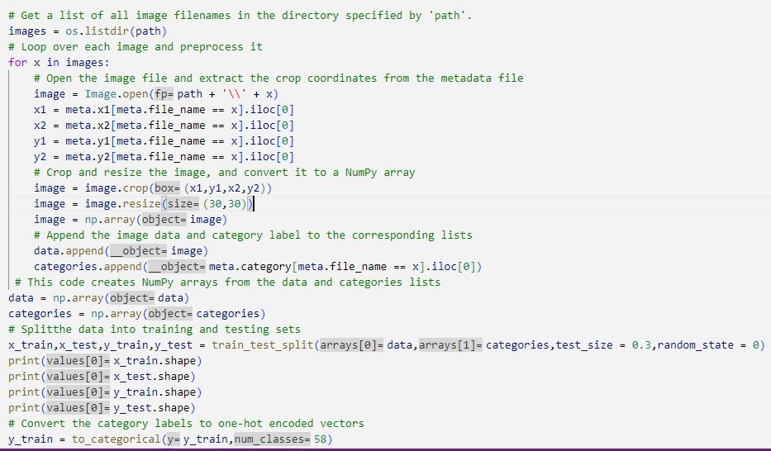
Preparing & processing images :-

Slide 6
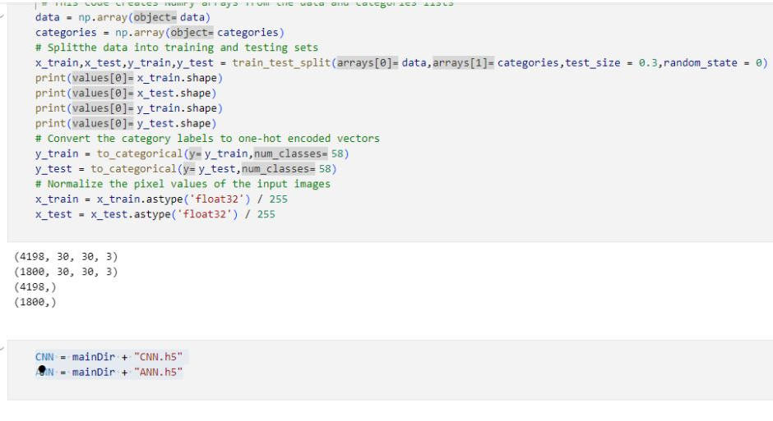

Slide 7
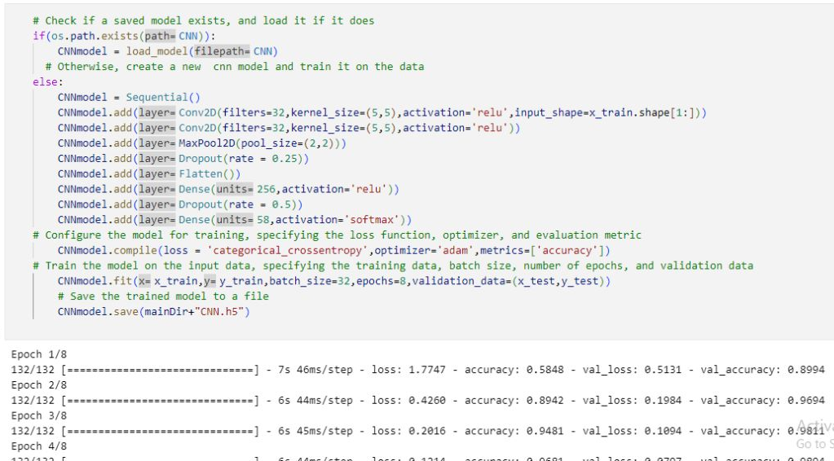
Creating CNN model :-

Slide 8
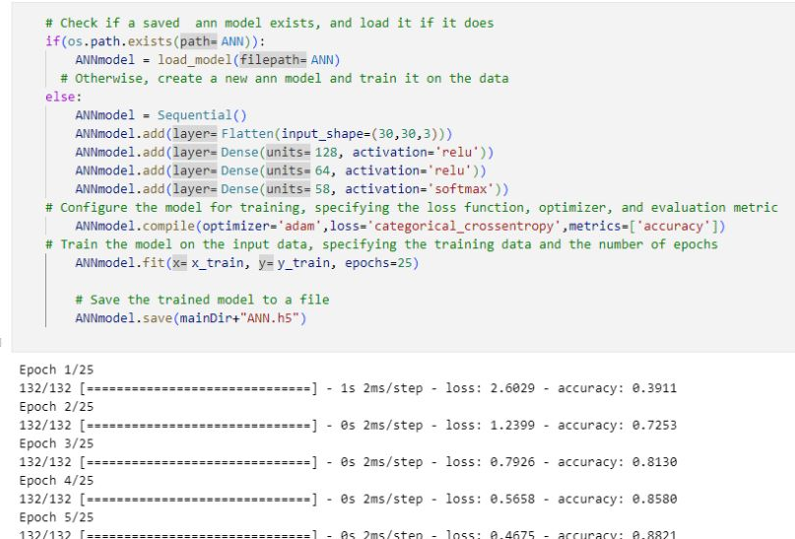
Creating ANN model :-

Slide 9
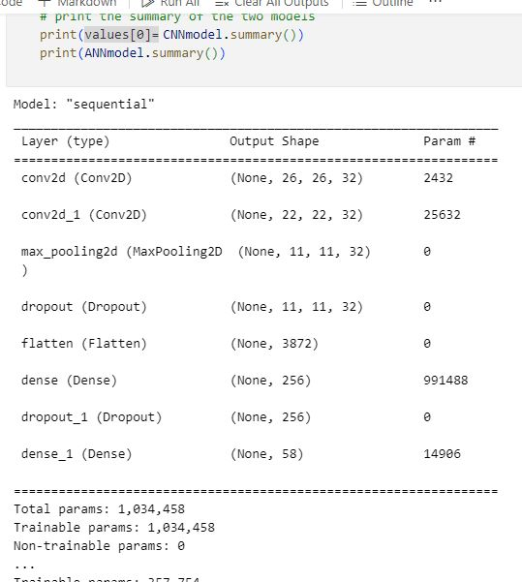
Summary of the two models :-

Slide 10
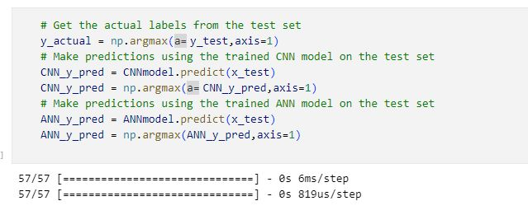

Slide 11
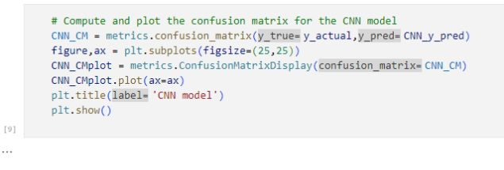
Code of Plot CNN model :-

Slide 12
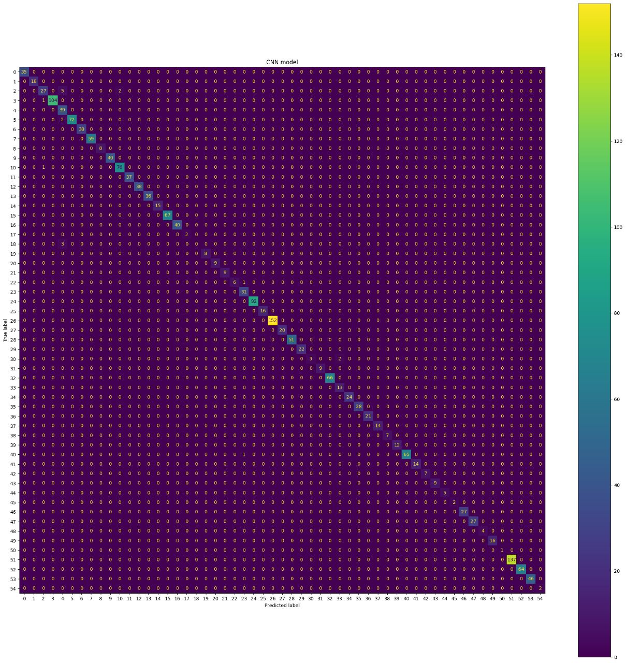

Slide 13
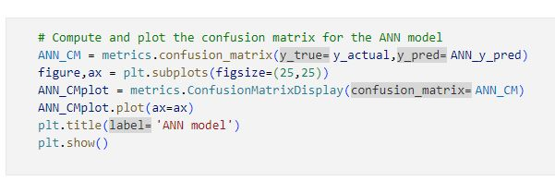
Code of Plot ANN model :-

Slide 14


Slide 15
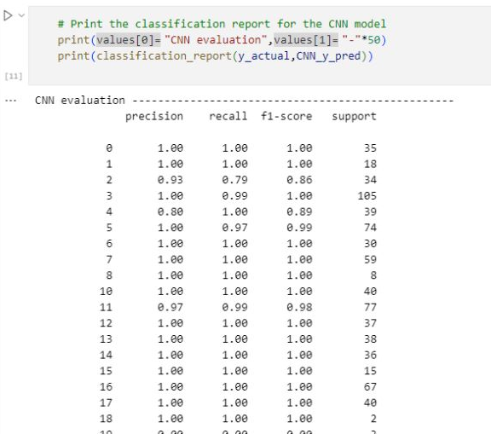
Print the classification report for the CNN model :-

Slide 16
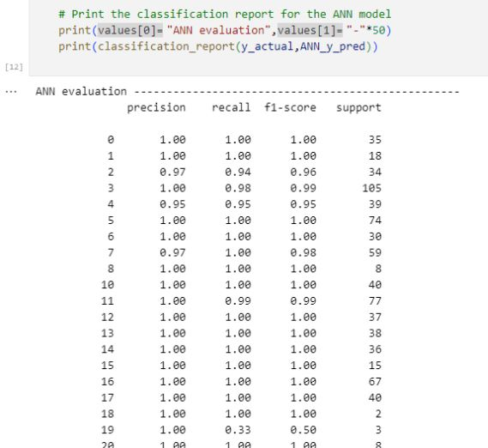
Print the classification report for the ANN model :-

Slide 17
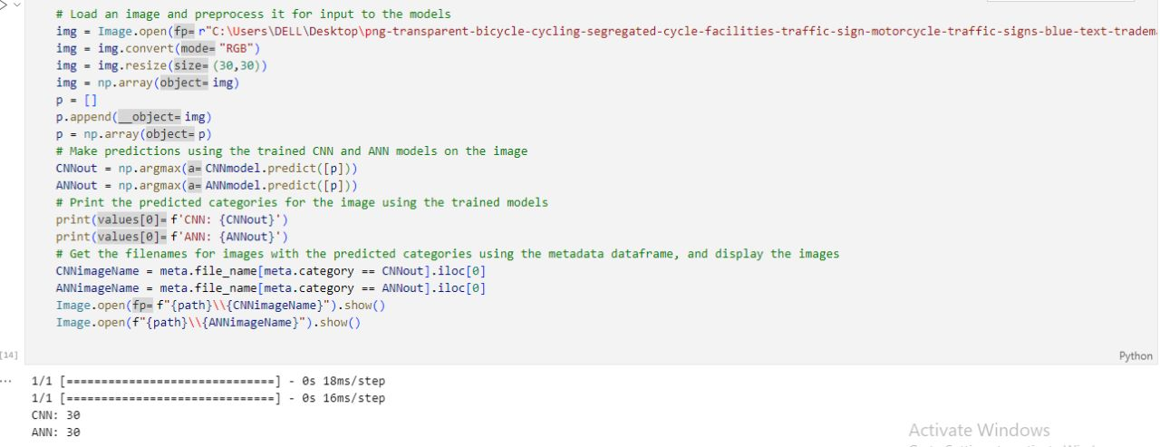
Make prediction by ANN & CNN model :-

Slide 18
ANN & CNN
CNN and ANN are both types of neural networks used for machine learning tasks , but they have some important differences.
ANN (Artificial Neural Networks) are a type of neural network that is used for general machine learning tasks, including classification, regression, and prediction.
ANN is a feedforward network, meaning that the information travels in one
direction, from input to output. It consists of input, hidden, and output layers, and
each layer is composed of neurons.
CNN (Convolutional Neural Networks) are a type of neural network that is
specialized for processing and classifying images. CNNs use a process called
convolution to extract features from images, and then use these features to classify the images. Convolution involves sliding a filter over the image and computing a dot product at each position.
CNNs are composed of input, convolutional, pooling, and
fully connected layers.

Slide 19
The main differences between CNNs and ANNs are:
1. CNNs are specialized for image processing tasks, whereas ANNs are more general-purpose.
2. CNNs use convolutional layers, which can extract features from images, whereas ANNs typically use fully connected layers.
3. CNNs can handle input data that is high-dimensional and has a grid-like structure (such as images), whereas ANNs are better suited for low-dimensional input data.
4. CNNs typically require more computational resources and training data than ANNs, due to their increased complexity and specialization.
In summary, CNNs are highly specialized neural networks designed for image processing tasks, while ANNs are more general-purpose.
CNNs use convolutional layers to extract features from images and can handle high-dimensional input data, while ANNs use fully connected layers and are better suited for low-dimensional input data.
Both types of neural networks can be useful for different machine
learning tasks depending on the data and the problem at hand.

Slide 20
Before we talk about the layers we have to say what is a sequential model.
A sequential model is a neural network model where every layer is stacked on the layer before it. So every output of a layer is an input for the following layer
The layers
Convolutional layer: This layer passes a filter or a kernel across a grid which is an image or a video and takes the dot product of it to extract features from it that can help us in classification of images for example
Pooling layer: This layer helps in downsizing the images by extracting the dominant feature in a local region it has different types but the one we used is max pooling
Fully connected layers: This layer is the last layer and it used to transform the input into what we need like classification

Slide 21
The layers
Dropout layer: This layer is a regularization layer which means it tries to prevent overfitting but how does it do that? The dropout layer deactivates the nodes that are under a certain threshold of probability. It has a rate that is mostly between 0.2 and 0.5 which is the percentage of neurons that are being deactivated
Flatten layer: This layer transforms its input from a multidimensional array to a vector
Concepts
We can’t talk about a neural network without talking about activations functions. They are mathematical functions that are used to add non-linearity. But what does it mean? It means that the output can’t be predicted directly from the input in a linear way. So how is that good? Well, it helps in modeling complex relationships since linear functions can only predict simple inputs. The output of the activation function is passed on to the next layer

Slide 22
Concepts
Some popular activation functions that we used are Relu and softmax
Relu: short for rectified linear unit and what makes it a popular and a useful activation function is that it’s mathematically simple and effective. It can be calculated as max(0,x) where x is its input. So it helps eliminating any negative values because it will be replaced with 0 which will help in neglecting those values in the feed forward.
One of it’s disadvantages is dying Relu. This happens when a neuron no longer outputs anything but 0
Softmax: A softmax activation function is used in the last layer because it generates probability distribution of the classes where each value is between 0 and 1 and they all sum up to 1. These values represent the likelihood that this input belongs to the following class. That’s why we use argmax because we want the index of the class where the probability distribution is the largest. And this mean that this specific class has the highest probability of becoming our output

Slide 23
Concepts
Loss function: The loss function is a way to calculate how good the model is. It calculates the difference between the actual output and the one our model produced. We use categorical crossentropy because it is better with multiclass labels and since we have 58 classes in our data we needed a loss function that can handle this amount of classes. After calculating the loss function we need to minimize it, because it is the error. So now the question is, how to do so?
Adam optimizer: It is an optimizing technique that we used to optimize our model. How does it work though? It simply tries to adjust the learning rate based on the history of gradients. Which means it runs a few gradients and calculate the learning rate based on them

Slide 24
Parameters
What is a parameter in a neural network? A parameter in a neural network can mean the weights of the ANN, the bias, or the activation function.
Another concept of parameters is the hyperparameter. This is the parameter that the model didn’t learn through time. This parameter is sent by the machine learning engineer. Examples on hyperparameters are the number of layers, the activation functions, the learning rate, or the batch size.
Wait, what is the batch size? The batch size is a hyperparameter that represents the number of samples the model used to train in each epoch it divides the data into smaller samples so that it can work faster and more efficient. We used a batch size of 32

